Slide 1
Planning in Continuous Spaces: Trajectory Optimization
Tom Silver
Robot Planning Meets Machine Learning
Princeton University
Fall 2025

Slide 2
Recap
Last time: Motion planning, our first foray into continuous spaces
This time: Planning in more general continuous spaces
For example, planning in cases where dynamics are important
Continue assuming full observability and determinism
New material and then full-course review game!

Slide 3
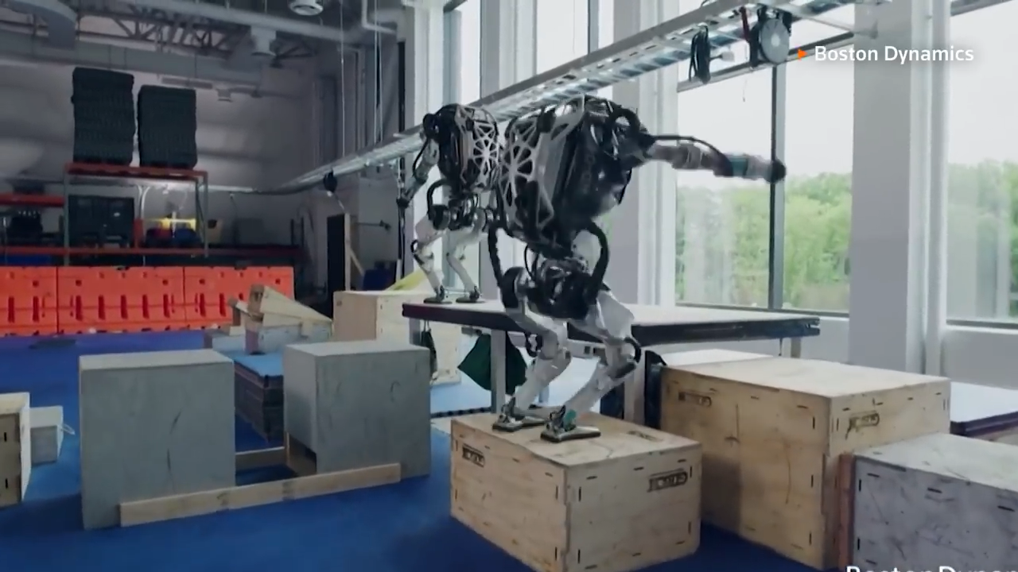

Slide 4
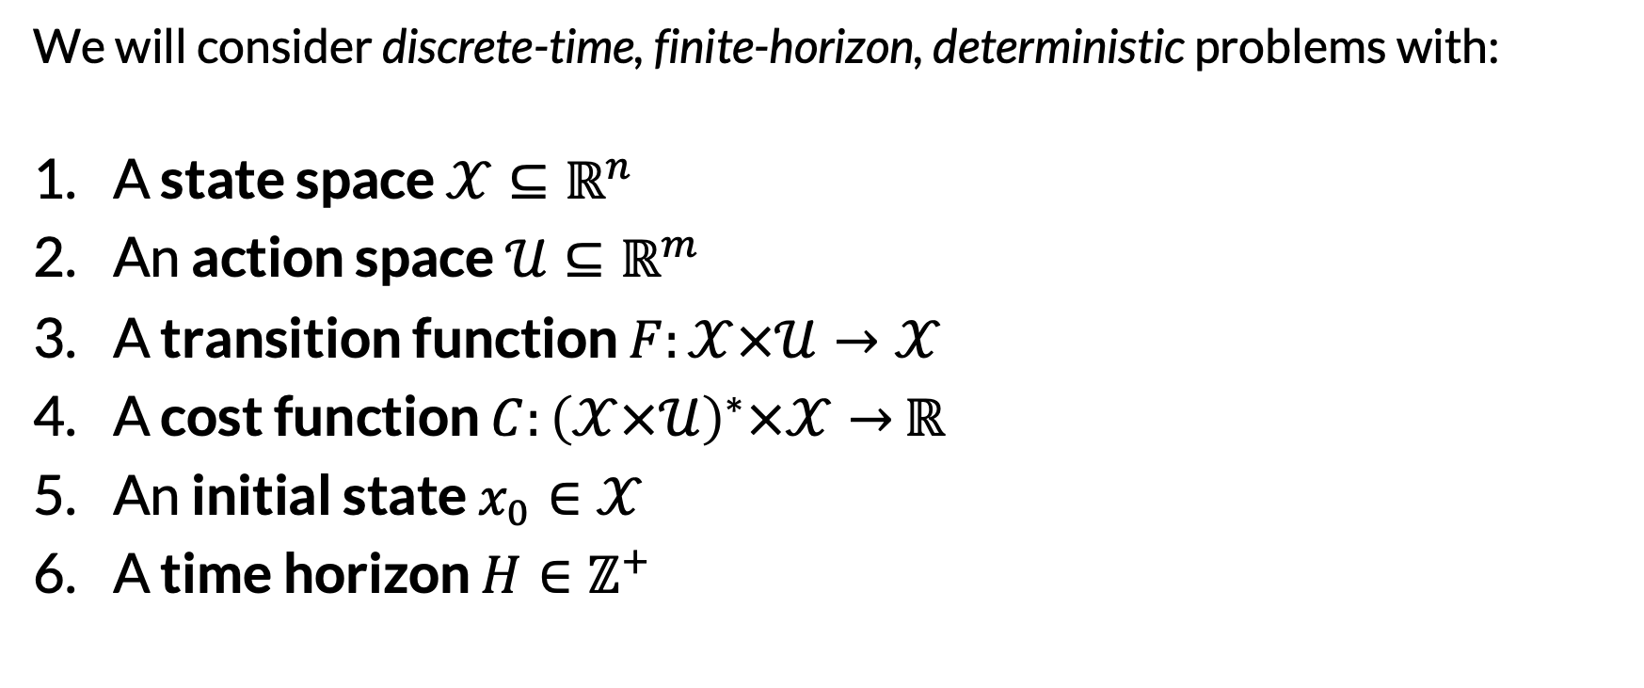
Trajectory Optimization Problems
We will consider discrete-time, finite-horizon, deterministic problems with:
A state space $𝒳⊆ℝ^{n}$
An action space $𝒰⊆ℝ^{m}$
A transition function $F:𝒳×𝒰→𝒳$
A cost function $C:{\left(𝒳×𝒰\right)}^{∗}×𝒳→$ $ℝ$
An initial state $x_{0}∈𝒳$
A time horizon $H∈ℤ^{+}$
Real-valued vectors
Over full trajectories! Common to sum over transition costs instead.

Slide 5
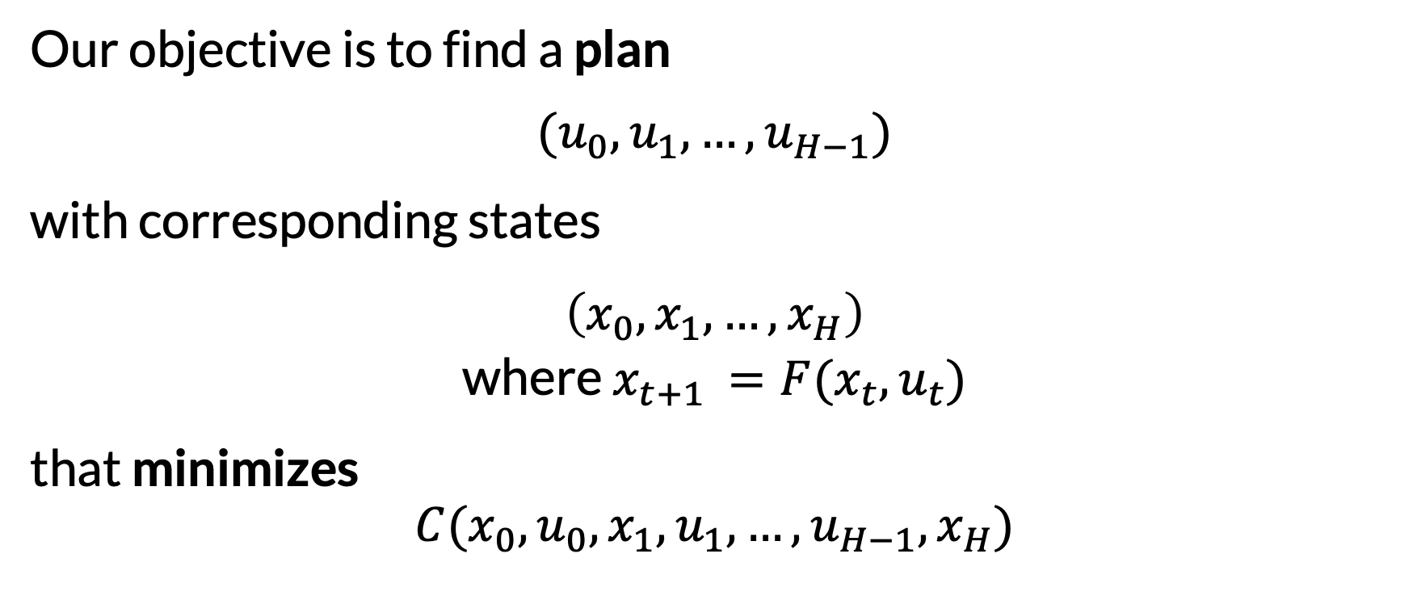
Trajectory Optimization Problems
Our objective is to find a plan
$$(u_{0},u_{1}, …,u_{H−1})$$
with corresponding states
$$\left(x_{0},x_{1}, …,x_{H}\right)$$
where $x_{t+1 }=F(x_{t}, u_{t})$
that minimizes
$$C(x_{0},u_{0},x_{1},u_{1}, …,u_{H−1}, x_{H})$$

Slide 6
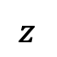
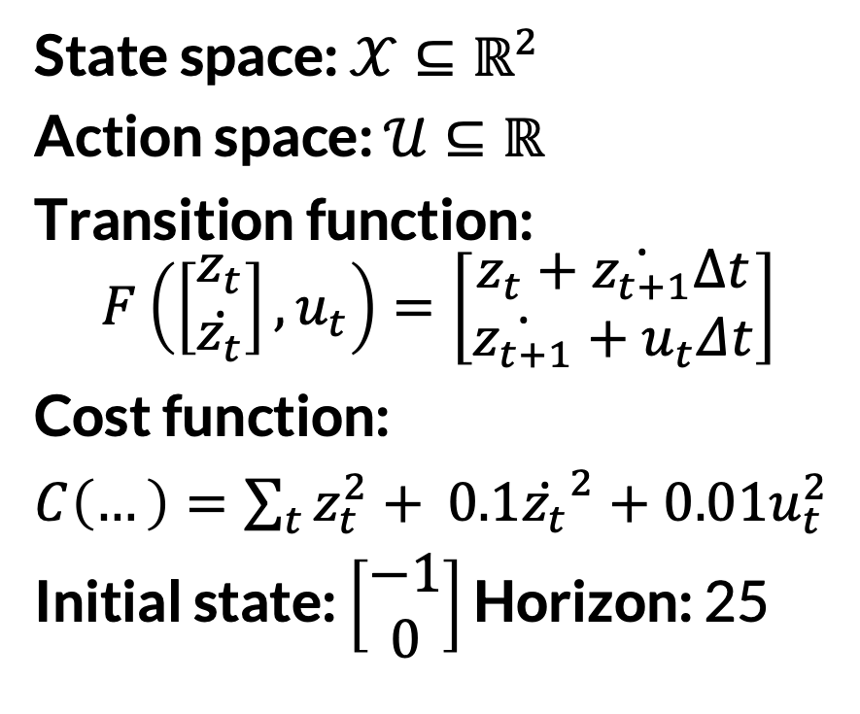
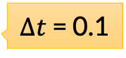
Example: Double Integrator
State space: $𝒳⊆ℝ^{2}$
Action space: $𝒰⊆ℝ$
Transition function:
$$F\left(\left[\begin{matrix}z_{t} \\ \dot{z_{t}}\end{matrix}\right], u_{t}\right)=\left[\begin{matrix}z_{t}+\dot{z_{t+1}}Δt \\ \dot{z_{t+1}}+u_{t}Δt\end{matrix}\right]$$
Cost function:
$C\left(…\right)=\sum_{t}{z_{t}^{2}+ }$ $0.1{\dot{z_{t}}}^{2}+0.01u_{t}^{2}$
Initial state: $\left[\begin{matrix}−1 \\ 0\end{matrix}\right]$ Horizon: 25
Position and Velocity
Acceleration
$Δt$ = 0.1
$$z$$
0

Slide 7
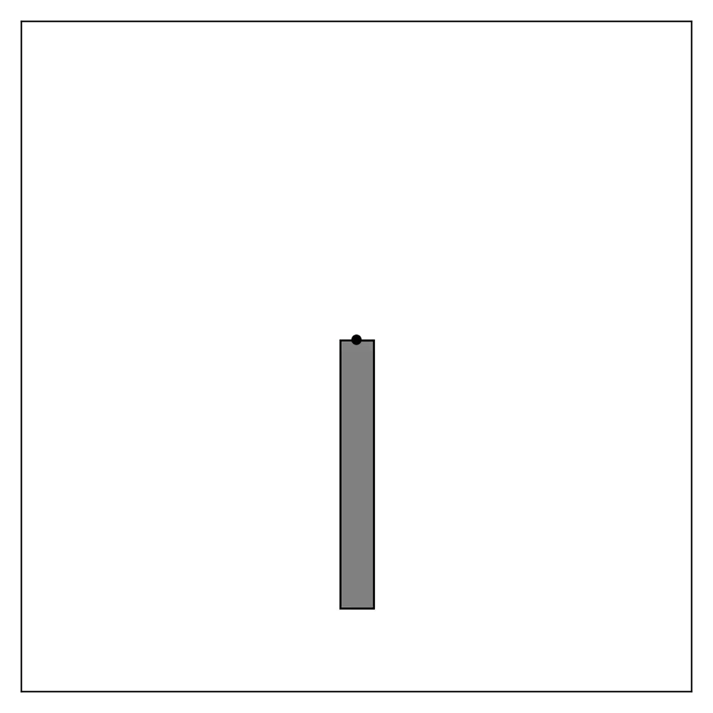
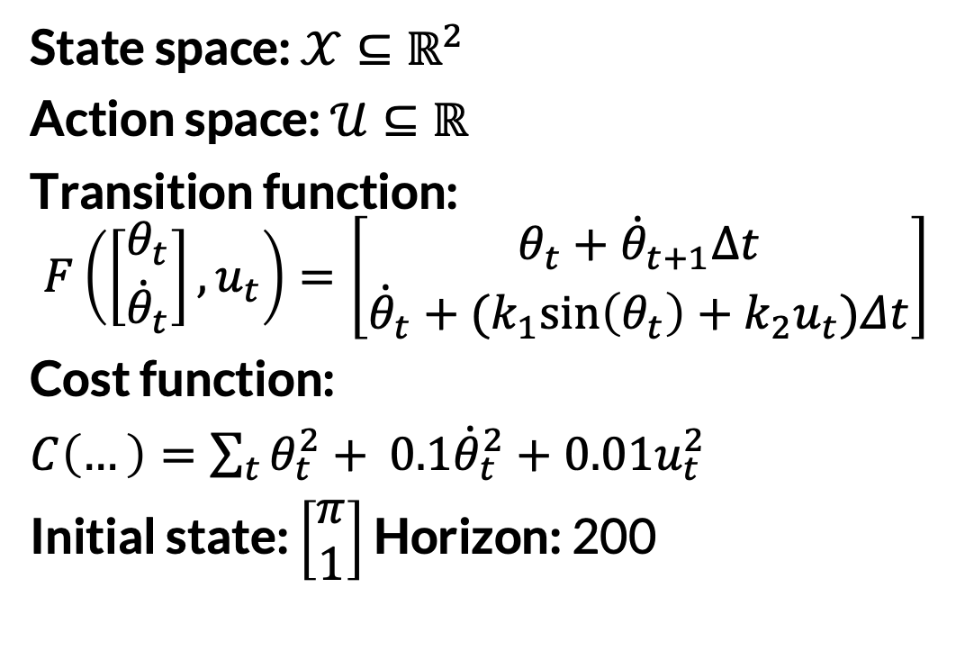
Example: Inverted Pendulum
State space: $𝒳⊆ℝ^{2}$
Action space: $𝒰⊆ℝ$
Transition function:
$$F\left(\left[\begin{matrix}θ_{t} \\ {\dot{θ}}_{t}\end{matrix}\right], u_{t}\right)=\left[\begin{matrix}θ_{t}+{\dot{θ}}_{t+1}Δt \\ {\dot{θ}}_{t}+{(k}_{1}\sin\left(θ_{t}\right)+k_{2}u_{t})Δt\end{matrix}\right]$$
Cost function:
$C\left(…\right)=\sum_{t}{θ_{t}^{2}+ }$ $0.1{\dot{θ}}_{t}^{2}+0.01u_{t}^{2}$
Initial state: $\left[\begin{matrix}π \\ 1\end{matrix}\right]$ Horizon: 200
Angle and Velocity
Torque

Slide 8
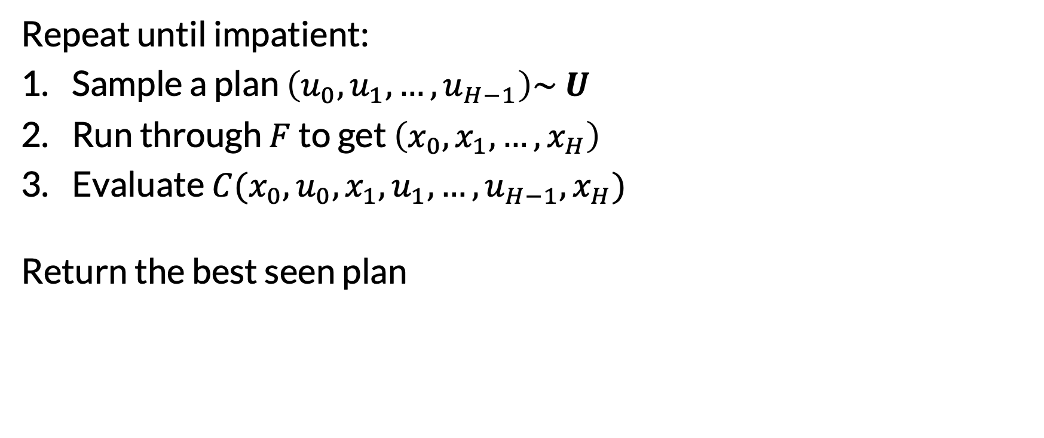
Stupidest Possible Algorithm
Repeat until impatient:
Sample a plan $\left(u_{0},u_{1}, …,u_{H−1}\right)\sim U$
Run through $F$ to get $\left(x_{0},x_{1}, …,x_{H}\right)$
Evaluate $C(x_{0},u_{0},x_{1},u_{1}, …,u_{H−1}, x_{H})$
Return the best seen plan
For example, from some Gaussian distribution

Slide 9
Trajectory Optimization Taxonomy
What is optimized? | Derivatives
Actions a.k.a. indirect or shooting | States and Actions a.k.a. direct transcription or collocation
What derivatives (of dynamics and costs) are required? | Derivatives
Zero-order | First-order | Second-order
To what extent is the approach specific to trajectory optimization? | Derivatives
Not really at all | Some | A lot

Slide 10
Stupidest Possible Algorithm
What is optimized? | Derivatives
Actions a.k.a. indirect or shooting | States and Actions a.k.a. direct transcription or collocation
What derivatives (of dynamics and costs) are required? | Derivatives
Zero-order | First-order | Second-order
To what extent is the approach specific to trajectory optimization? | Derivatives
Not really at all | Some | A lot

Slide 11
Can We Do Better in this Category?
What is optimized? | Derivatives
Actions a.k.a. indirect or shooting | States and Actions a.k.a. direct transcription or collocation
What derivatives (of dynamics and costs) are required? | Derivatives
Zero-order | First-order | Second-order
To what extent is the approach specific to trajectory optimization? | Derivatives
Not really at all | Some | A lot

Slide 12
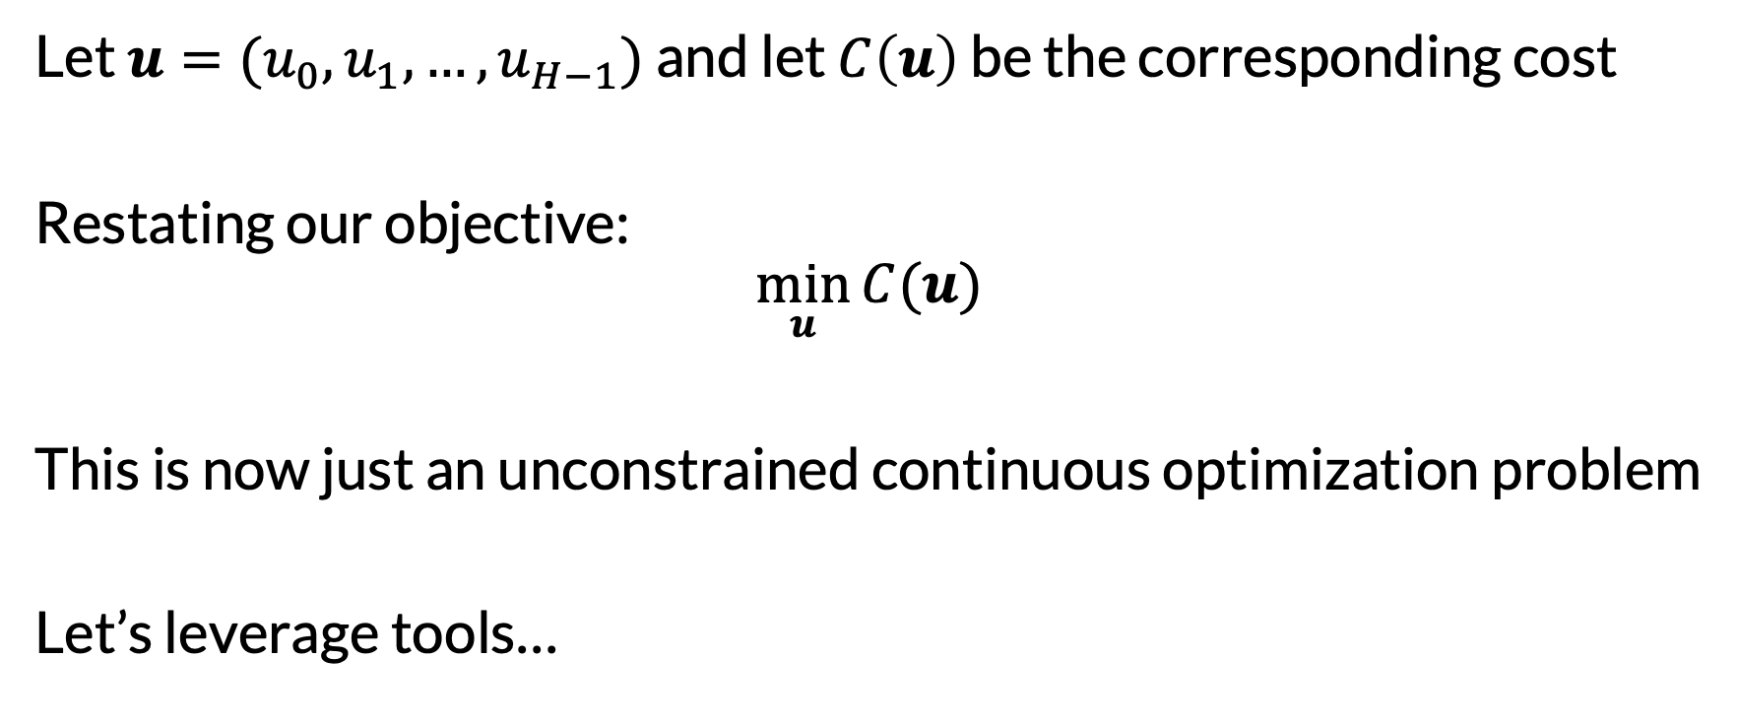
Shooting as Unconstrained Optimization
Let $u=(u_{0}, u_{1}, …,u_{H−1})$ and let $C\left(u\right)$ be the corresponding cost
Restating our objective:
$$\min_{u}{C(u)}$$
This is now just an unconstrained continuous optimization problem
Let’s leverage tools…

Slide 13
Zero-Order Continuous Optimization
A.k.a. “derivative-free” or “blackbox” optimization
Notable examples:
Random search
Cross-entropy method
Bayesian optimization
Evolution strategies
Nelder-Mead
We will briefly discuss these

Slide 14
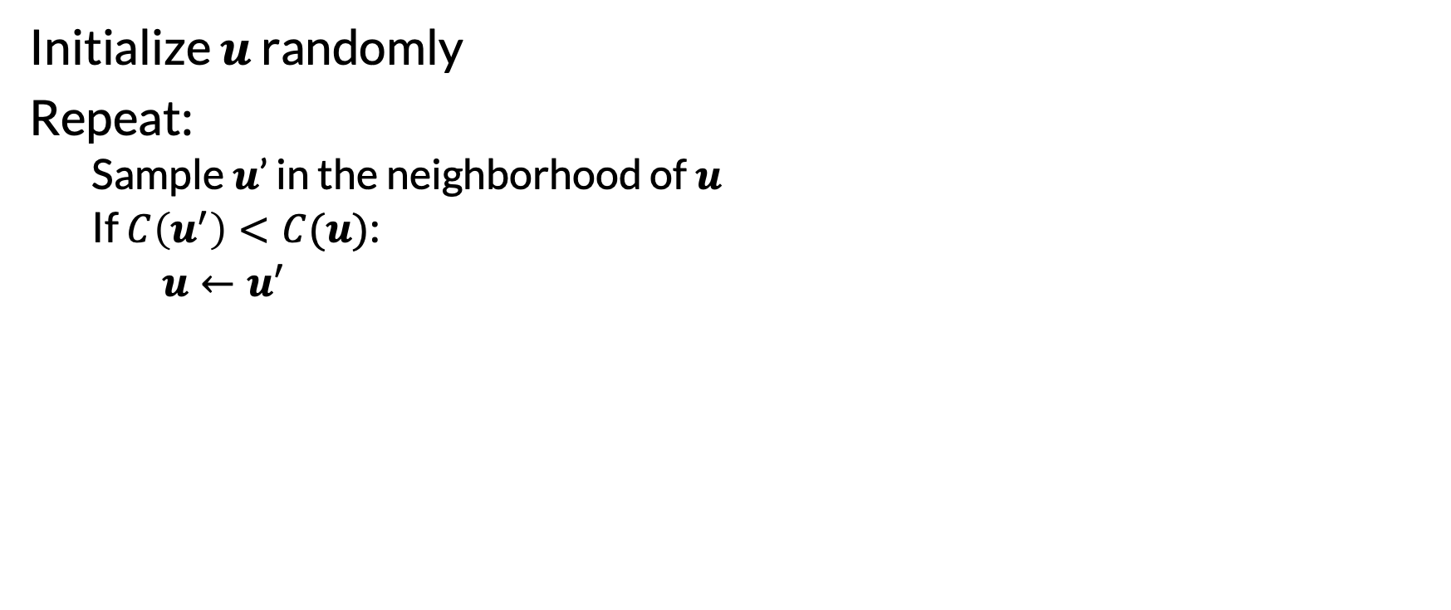
Random Search
Limitation: sampling does not adapt!
Initialize $u$ randomly
Repeat:
Sample $u$’ in the neighborhood of $u$
If $C\left(u^{′}\right)<C(u)$:
$u←u′$
When might this work better than our SPA?
Many possible variations on “neighborhood”
“Algorithms that are invented independently by four different communities probably have something good going for them.” – Ben Recht (2018)

Slide 15
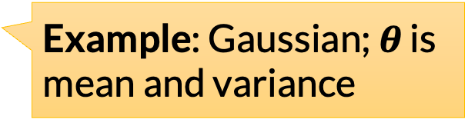
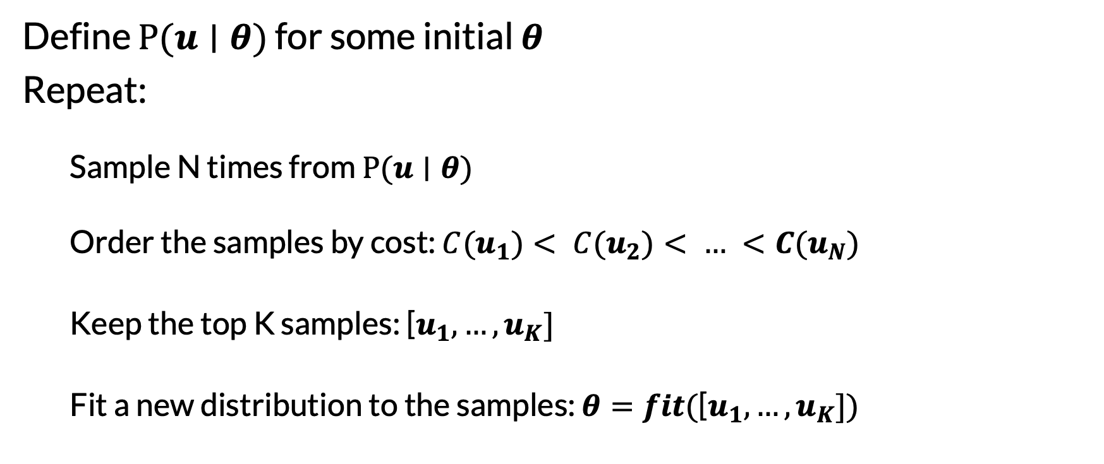
Cross-Entropy Method
Define $P(u∣θ)$ for some initial $θ$
Repeat:
Sample N times from $P(u∣θ)$
Order the samples by cost: ${C(u}_{1})< {C(u}_{2})< … <{C(u}_{N})$
Keep the top K samples: [$u_{1}, …, u_{K}]$
Fit a new distribution to the samples: $θ=fit($[$u_{1}, …, u_{K}])$
Example: Gaussian; $θ$ is mean and variance
Example: compute mean and variance

Slide 16
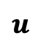
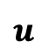
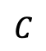
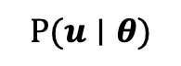
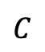
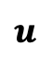
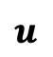
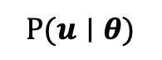
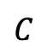
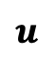
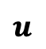
Illustration of CEM
$$C$$
$$C$$
$$C$$
$$u$$
$$u$$
$$u$$
$$P(u∣θ)$$
$$P(u∣θ)$$
$$P(u∣θ)$$
$$u$$
$$u$$
$$u$$
Samples
Samples
Samples
$$u$$
$$u$$
$$u$$

Slide 17
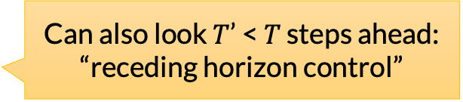
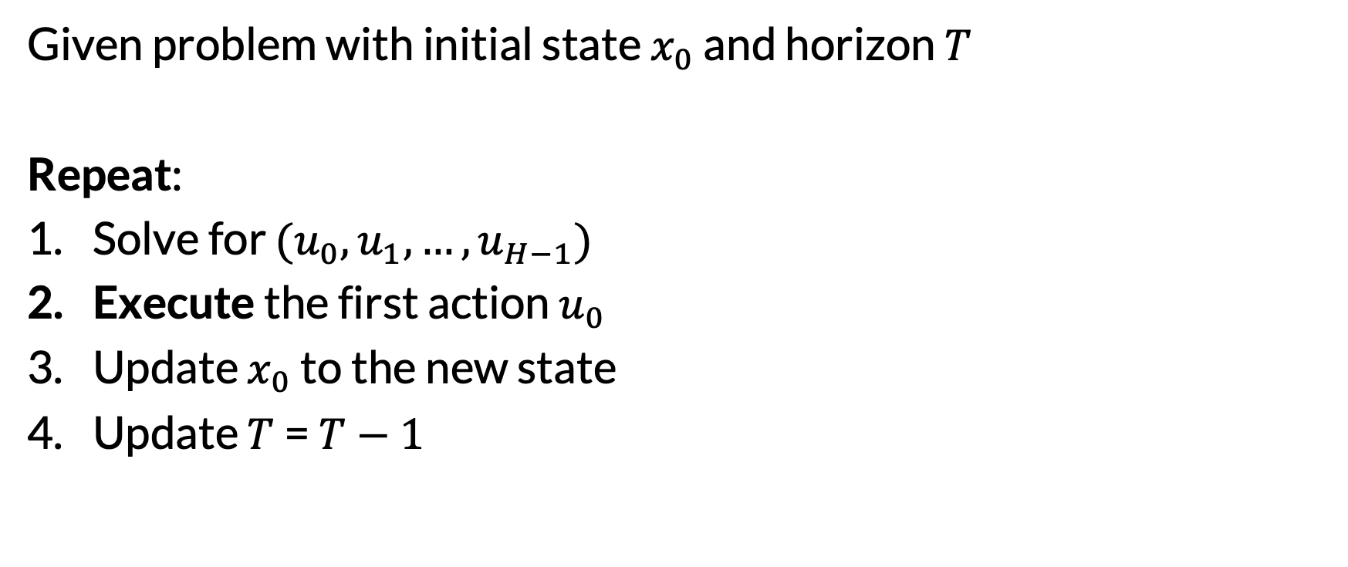
General Trick 1: Model-Predictive Control
Given problem with initial state $x_{0}$ and horizon $T$
Repeat:
Solve for $(u_{0}, u_{1}, …,u_{H−1})$
Execute the first action $u_{0}$
Update $x_{0}$ to the new state
Update $T$ = $T−1$
Can also look $T$’ < $T$ steps ahead: “receding horizon control”
Common to run one step of iterative optimization
Important: warm-start optimization from previous step
Main benefit: solving can be very approximate, as long as it’s fast

Slide 18
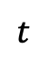
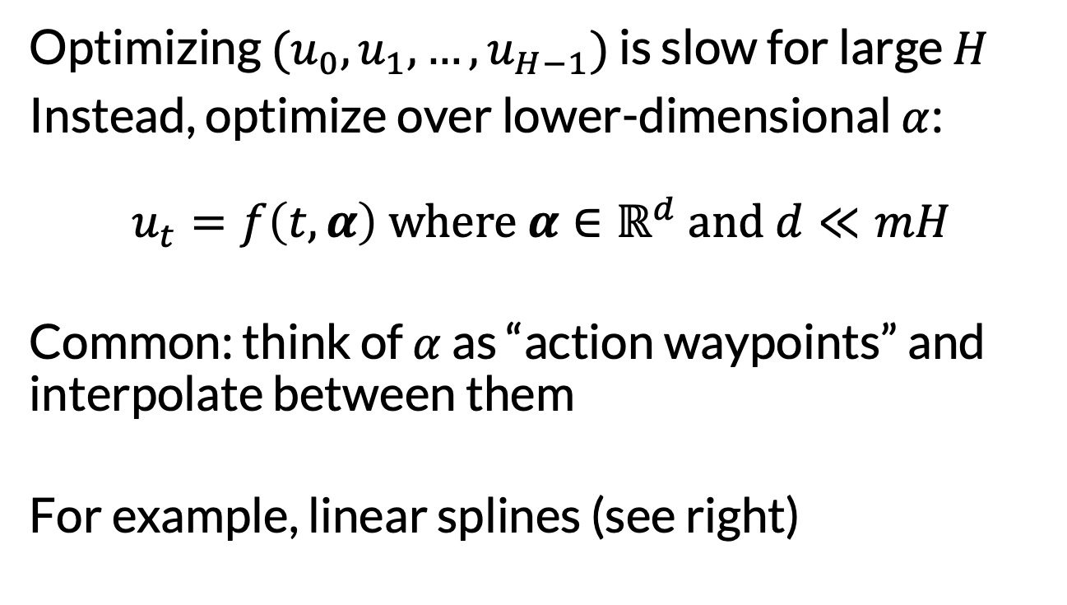
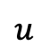
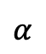
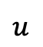
General Trick 2: Optimize Splines Instead
Optimizing $(u_{0}, u_{1}, …,u_{H−1})$ is slow for large $H$
Instead, optimize over lower-dimensional $α$: $$u_{t}=f\left(t, α\right) where α∈ℝ^{d} and d≪mH$$
Common: think of $α$ as “action waypoints” and interpolate between them
For example, linear splines (see right)
$$u$$
$$α$$
$$u$$
$$t$$

Slide 19
General Trick 3: Initialize Well
For iterative methods (which most are), the initialization matters!
Extreme case: initialize at the global optimum
More common: try to initialize “near” a “good local optimum”
One trick: solve a reduced problem to get an initialization
Similar in spirit to deriving heuristics from problem relaxations
The backflipping BD robot does this!
Also helpful for debugging

Slide 20
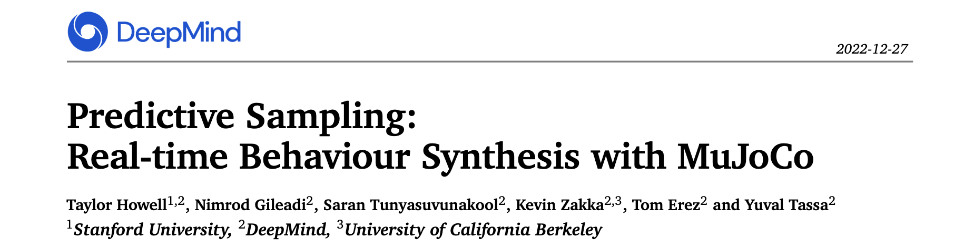
Predictive Sampling
MPC + Splines + Random Search
Sometimes works surprisingly well

Slide 21
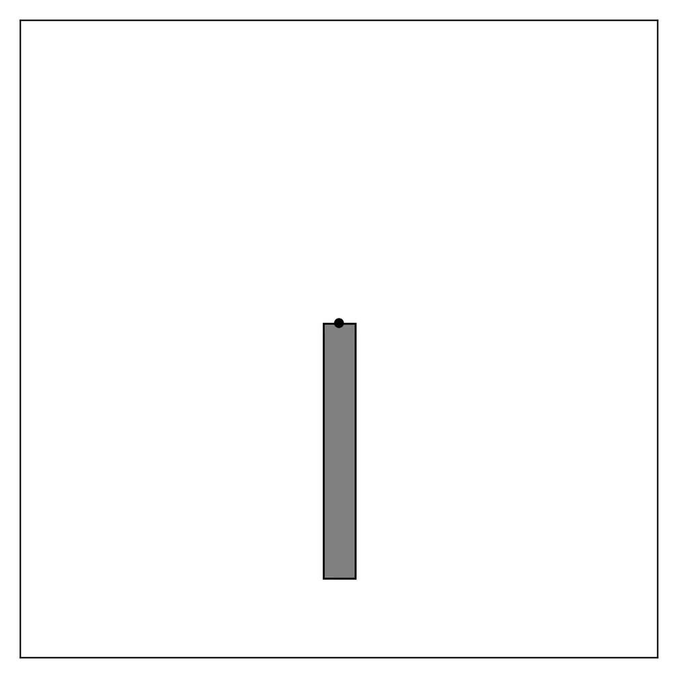
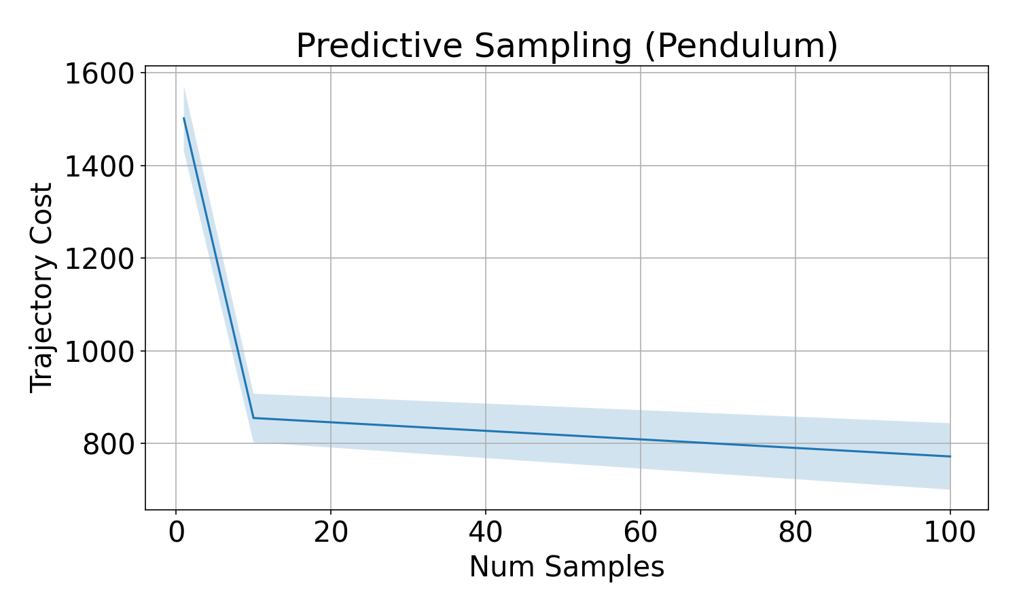
Predictive Sampling in Pendulum Env

Slide 22
Predictive Sampling
What is optimized? | Derivatives
Actions a.k.a. indirect or shooting | States and Actions a.k.a. direct transcription or collocation
What derivatives (of dynamics and costs) are required? | Derivatives
Zero-order | First-order | Second-order
To what extent is the approach specific to trajectory optimization? | Derivatives
Not really at all | Some | A lot

Slide 23
Gradient-Based Shooting Methods
What is optimized? | Derivatives
Actions a.k.a. indirect or shooting | States and Actions a.k.a. direct transcription or collocation
What derivatives (of dynamics and costs) are required? | Derivatives
Zero-order | First-order | Second-order
To what extent is the approach specific to trajectory optimization? | Derivatives
Not really at all | Some | A lot

Slide 24
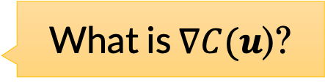
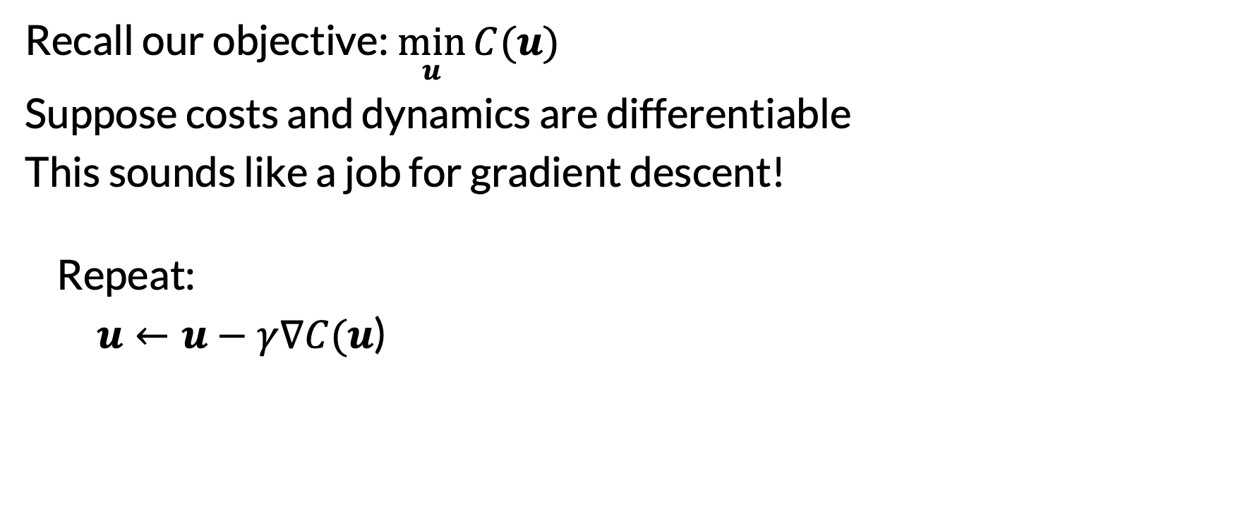
Gradient Descent
Recall our objective:$\min_{u}{C(u)}$
Suppose costs and dynamics are differentiable
This sounds like a job for gradient descent!
Repeat:
$u←u−γ∇C(u$)
Or approximate with finite differences (e.g., MuJoCo does this)
Or SGD, or Adam, or whatever…
What is $∇C(u$)?

Slide 25
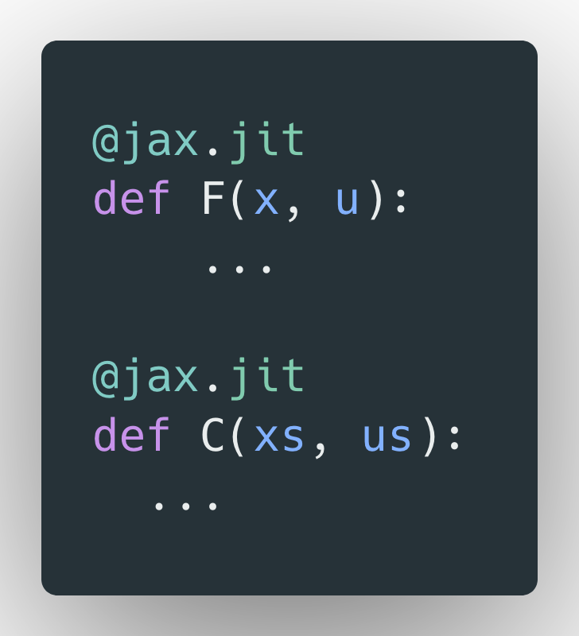
Calculate a Gradient? Myself?
Or we can let autodiff do it for us
We then need to define the dynamics & costs in those terms
Tensorflow, PyTorch, JAX, etc.

Slide 26
Example: Double Integrator
State space: $𝒳⊆ℝ^{2}$
Action space: $𝒰⊆ℝ$
Transition function:
$$F\left(\left[\begin{matrix}z_{t} \\ \dot{z_{t}}\end{matrix}\right], u_{t}\right)=\left[\begin{matrix}z_{t}+\dot{z_{t+1}}Δt \\ \dot{z_{t+1}}+u_{t}Δt\end{matrix}\right]$$
Cost function:
$C\left(…\right)=\sum_{t}{z_{t}^{2}+ }$ $0.1{\dot{z_{t}}}^{2}+0.01u_{t}^{2}$
Initial state: $\left[\begin{matrix}−1 \\ 0\end{matrix}\right]$ Horizon: 25
Position and Velocity
Acceleration
$Δt$ = 0.1
$$z$$
0

Slide 27
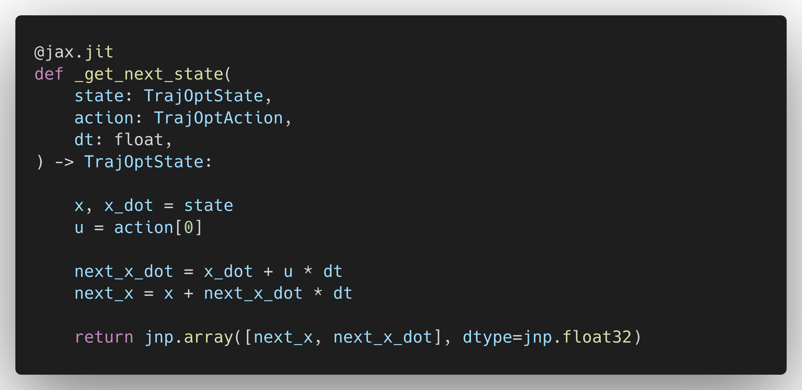

Slide 28
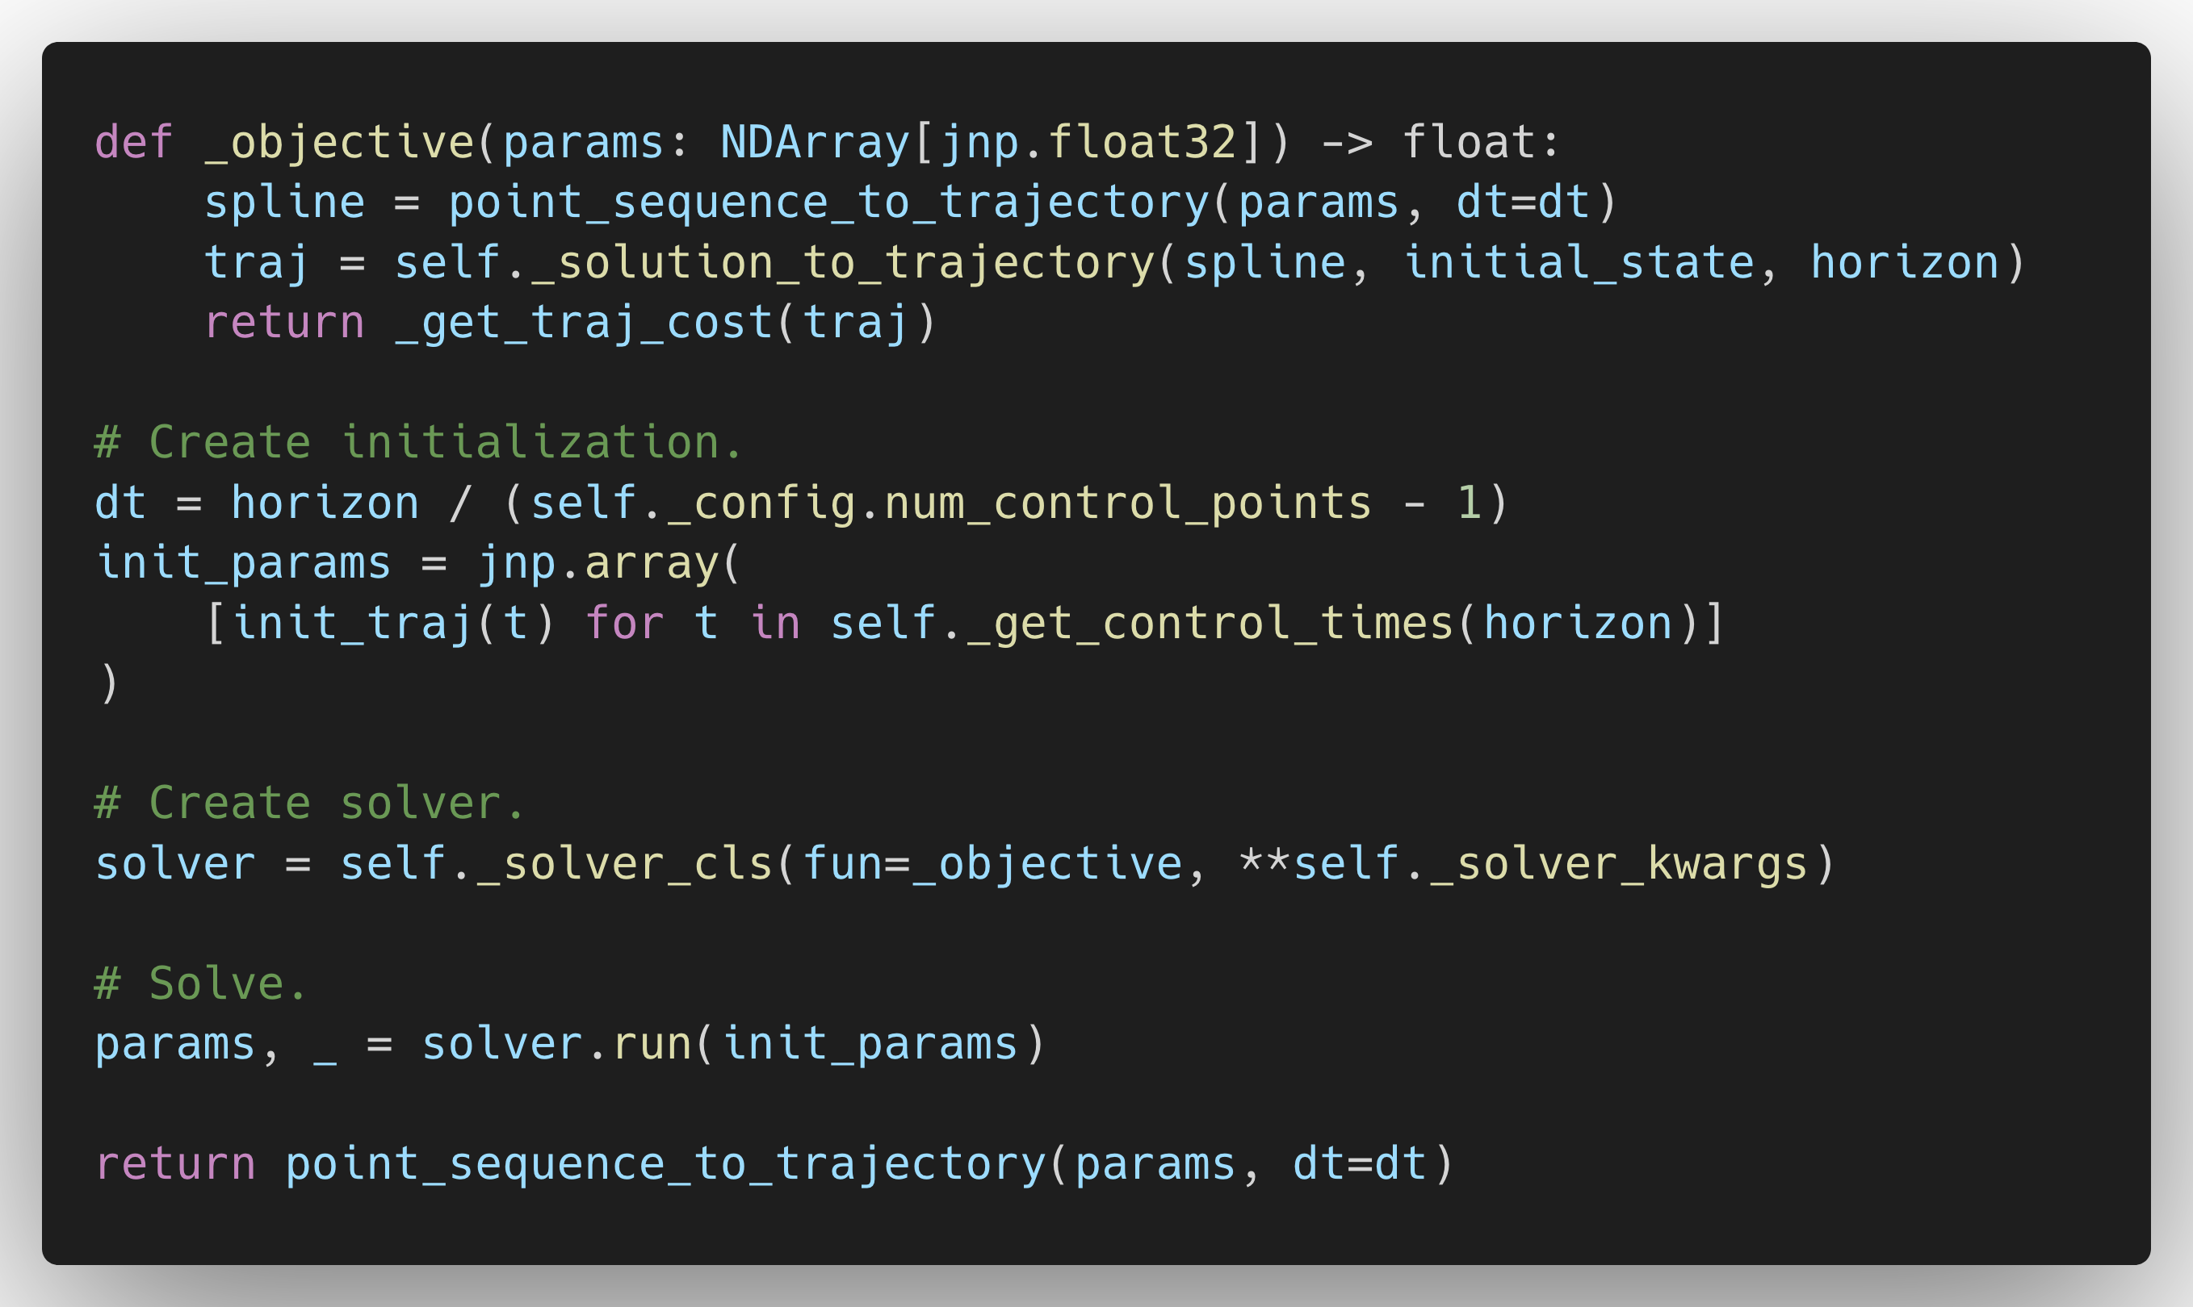

Slide 29
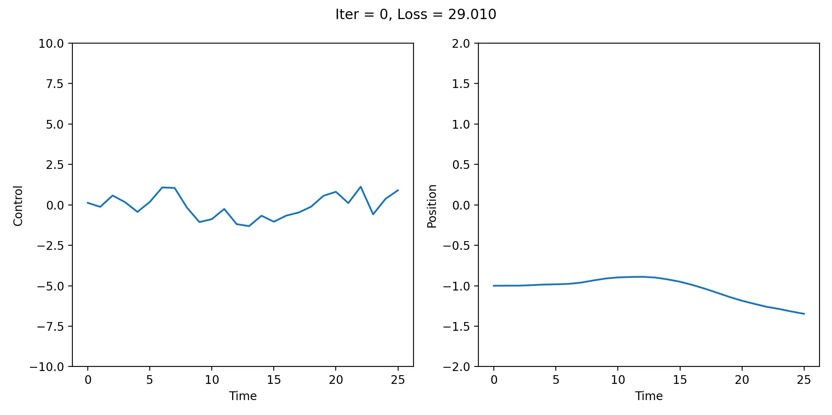
Gradient Descent with JAX in Double Integrator

Slide 30
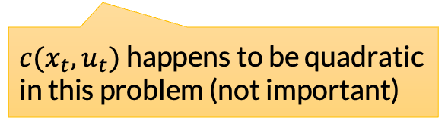
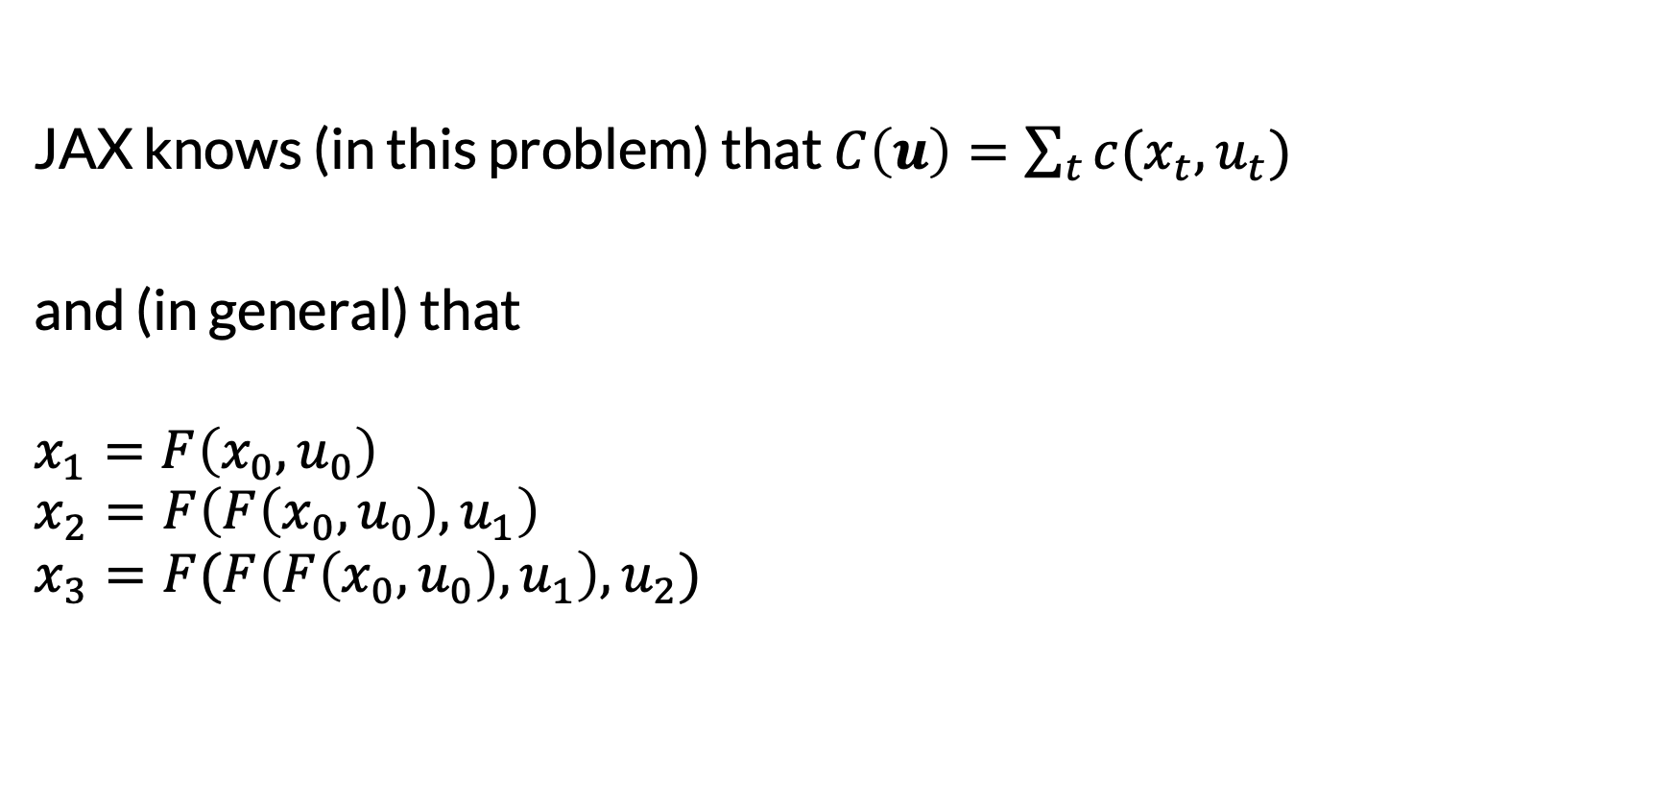
Behind the Scenes
JAX knows (in this problem) that $C\left(u\right)=\sum_{t}{c(x_{t}, u_{t})}$
and (in general) that
$$x_{1}=F\left(x_{0},u_{0}\right)$$
$$x_{2}=F\left(F\left(x_{0},u_{0}\right),u_{1}\right)$$
$$x_{3}=F(F\left(F\left(x_{0},u_{0}\right),u_{1}\right), u_{2})$$
$c(x_{t}, u_{t})$ happens to be quadratic in this problem (not important)
This is reminiscent of the function composition in neural networks…

Slide 31
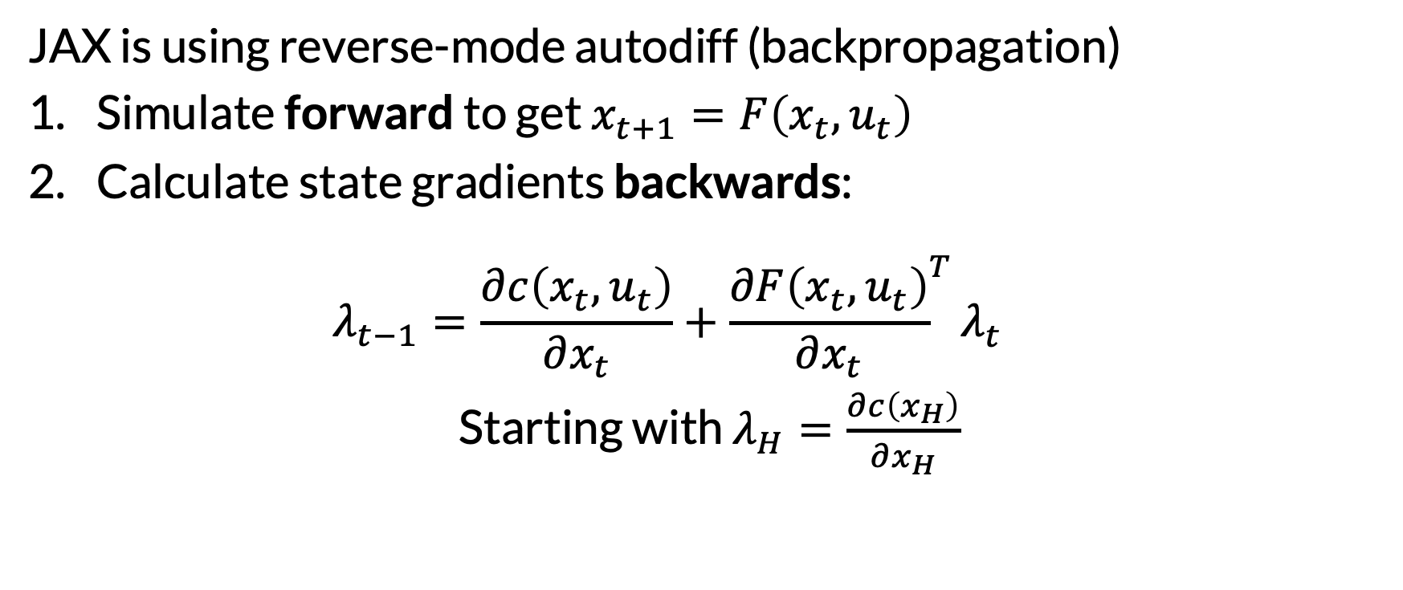
Behind the Scenes
JAX is using reverse-mode autodiff (backpropagation)
Simulate forward to get $x_{t+1}=F\left(x_{t},u_{t}\right)$
Calculate state gradients backwards: $λ_{t−1}=\frac{∂c\left(x_{t},u_{t}\right)}{∂x_{t}}+{\frac{∂F\left(x_{t},u_{t}\right)}{∂x_{t}}}^{T}λ_{t}^{}$
Starting with $λ_{H}=\frac{∂c\left(x_{H}\right)}{∂x_{H}}$
“Co-state”
“Adjoint equation”

Slide 32
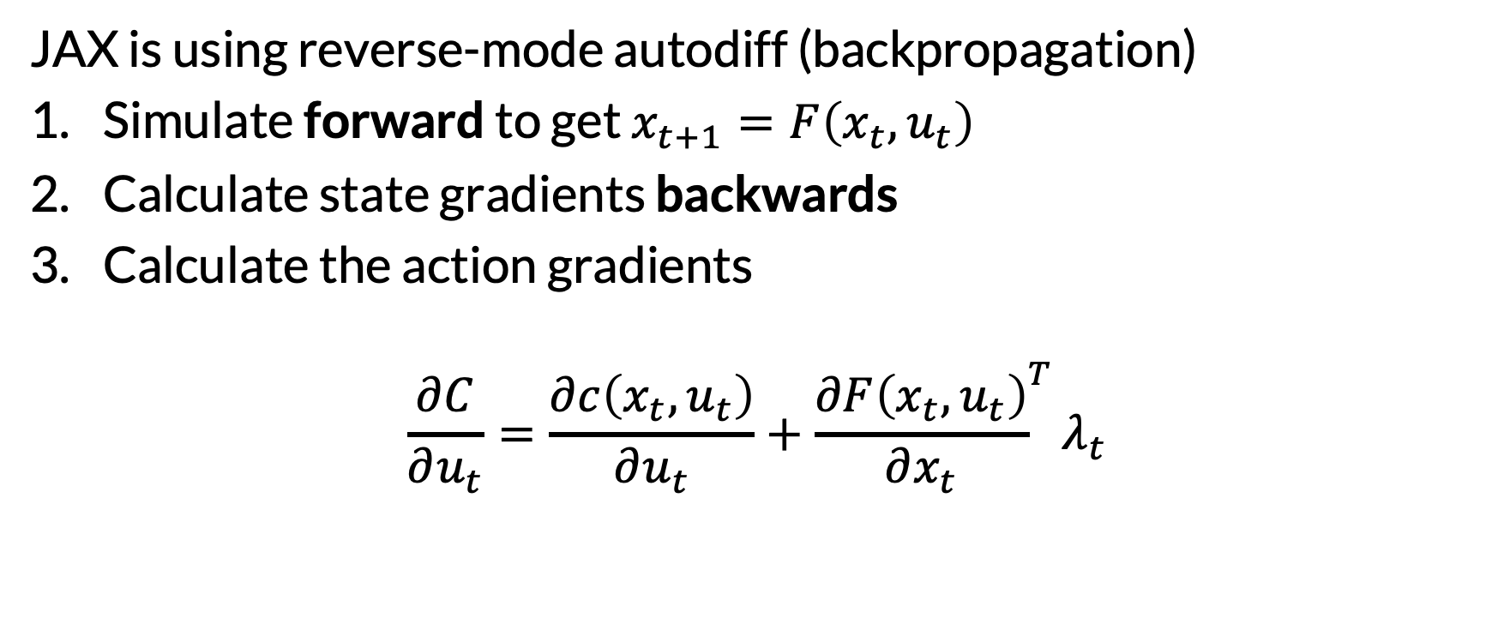
Behind the Scenes
JAX is using reverse-mode autodiff (backpropagation)
Simulate forward to get $x_{t+1}=F\left(x_{t},u_{t}\right)$
Calculate state gradients backwards
Calculate the action gradients
$$\frac{∂C}{∂u_{t}}=\frac{∂c\left(x_{t},u_{t}\right)}{∂u_{t}}+{\frac{∂F\left(x_{t},u_{t}\right)}{∂x_{t}}}^{T}λ_{t}$$
Take a moment to appreciate that this is way better than naïve gradient calculation!

Slide 33
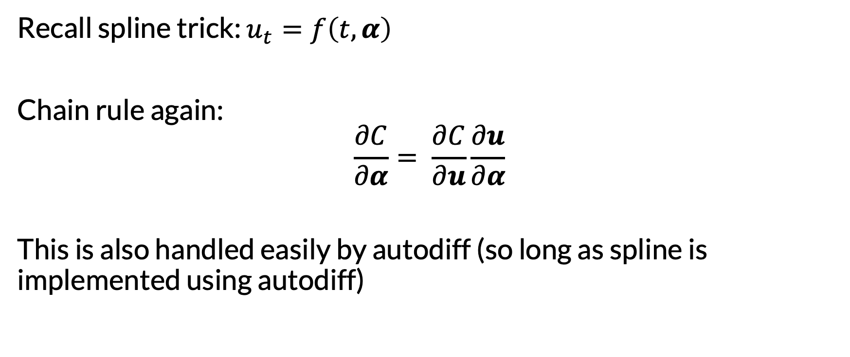
Differentiating through Splines
Recall spline trick: $u_{t}=f\left(t, α\right)$
Chain rule again:
$$\frac{∂C}{∂α}= \frac{∂C}{∂u}\frac{∂u}{∂α}$$
This is also handled easily by autodiff (so long as spline is implemented using autodiff)

Slide 34
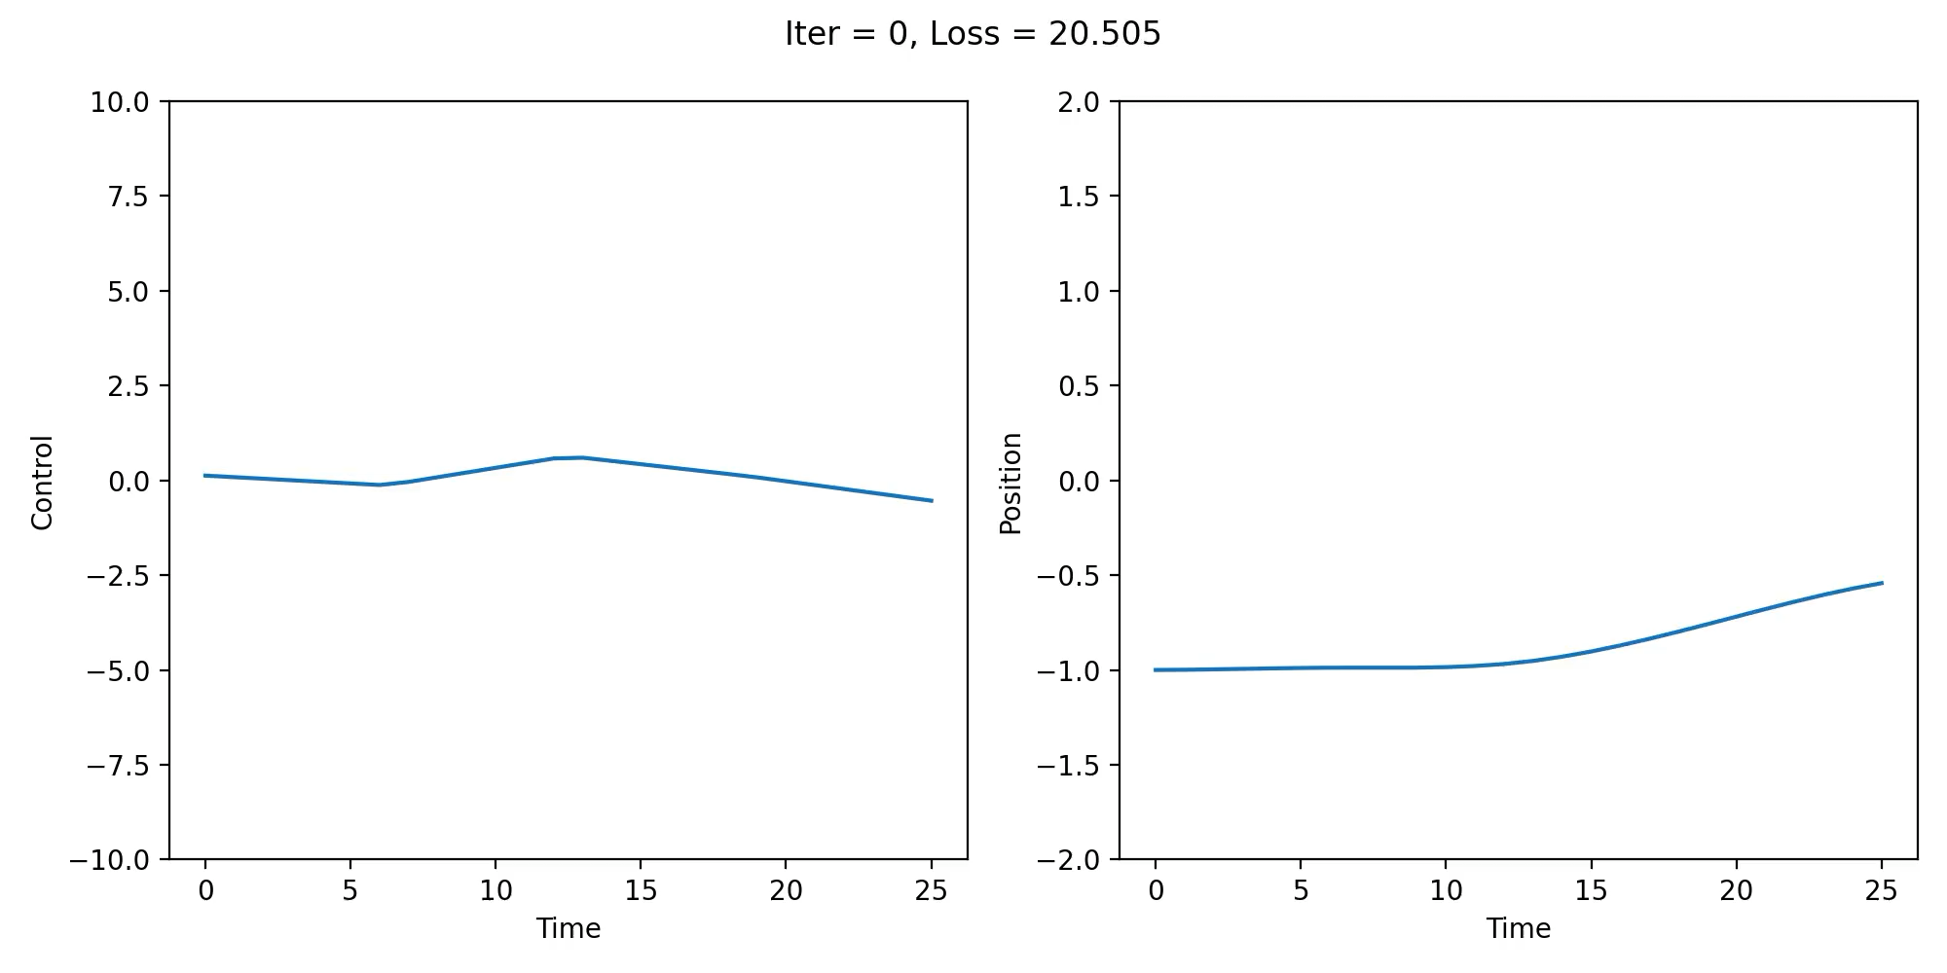
# control points = 5

Slide 35
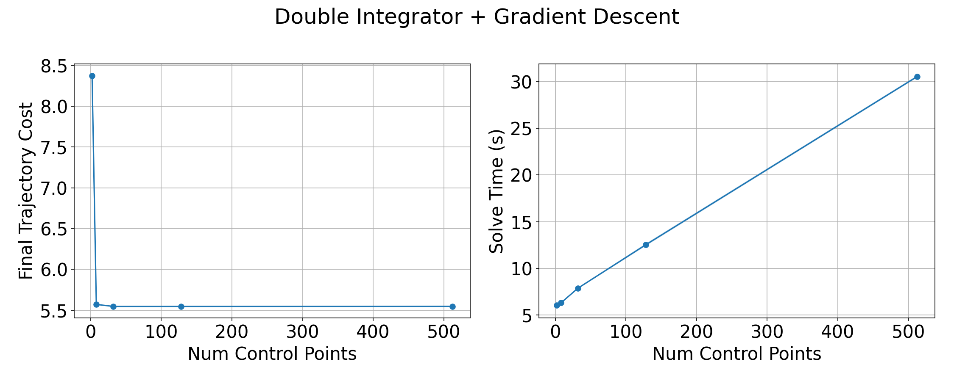
Trading Off Speed and Cost

Slide 36

Gradient Descent in Pendulum
It is certainly possible to do better than this, but it is very finicky…

Slide 37

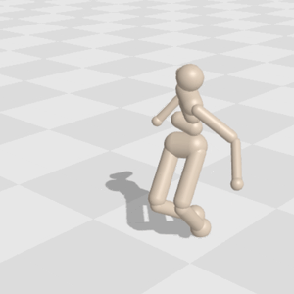
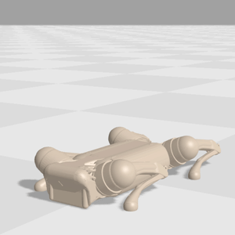
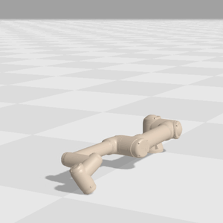
Differentiable Physics Engines
See also:
Dojo (Howell et al. 2022)
End-to-End Differentiable Physics for Learning and Control (De Avila Belbute Peres et al. 2018)
Tiny Differentiable Simulator (Coumans 2020)
Several others
Freeman et al. (2021)

Slide 38
Second-Order Shooting Methods
What is optimized? | Derivatives
Actions a.k.a. indirect or shooting | States and Actions a.k.a. direct transcription or collocation
What derivatives (of dynamics and costs) are required? | Derivatives
Zero-order | First-order | Second-order
To what extent is the approach specific to trajectory optimization? | Derivatives
Not really at all | Some | A lot

Slide 39


Newton’s Method (a.k.a. Newton–Raphson)
For a twice differentiable function $f(x)$ that we want to minimize:
$$x_{i+1}=x_{i}+{\left[f^{′′}\left(x\right)\right]}^{−1}f′(x)$$
(Initialize $x_{0}$ and repeat to converge)
Uses Hessian $f^{′′}\left(x\right)$, so 2nd order
Need to be careful if Hessian is not PSD; Taylor parabola would flip

Slide 40
Differential Dynamic Programming
What is optimized? | Derivatives
Actions a.k.a. indirect or shooting | States and Actions a.k.a. direct transcription or collocation
What derivatives (of dynamics and costs) are required? | Derivatives
Zero-order | First-order | Second-order
To what extent is the approach specific to trajectory optimization? | Derivatives
Not really at all | Some | A lot

Slide 41

Differential Dynamic Programming (DDP)
See excellent reference: “Control-Limited Differential Dynamic Programming” (Tassa et al. 2014)
Let’s apply Newton’s method to our shooting problem: $\min_{u}{C(u)}$
As with gradient descent, want to avoid naïve computation
Especially now that we need Hessians!
We will do a similar forward-backward procedure, but this time:
Estimate cost-to-go (value function) at each step
Use second-order info
Build up explicit function approximations

Slide 42

Differential Dynamic Programming (DDP)
(Hamilton-Jacobi-) Bellman Equations:
$$V_{H}\left(x_{H}\right)=c(x_{H})$$
$$V_{t}\left(x_{t}\right)=\min_{u_{t}}{c\left(x_{t}, u_{t}\right)+V_{t+1}(F\left(x_{t}, u_{t}\right)) }$$
Forward pass, given nominal $u$:
$$x_{1}=F\left(x_{0},u_{0}\right)$$
$$x_{2}=F\left(x_{1},u_{1}\right)$$
$$x_{3}=F(x_{2}, u_{2})$$
…
Same as we’re used to, just simpler because of no stochasticity
Same as in gradient descent

Slide 43


Differential Dynamic Programming (DDP)
Consider the usual Q functions, but now centered around nominal trajectory. So the input is a difference with respect to the nominal:
$Q_{t}\left({∂x}_{t}, ∂u_{t}\right)=c(x_{t}+{∂x}_{t}$, $u_{t}+{∂u}_{t})+V_{t+1}\left(F\left(x_{t}+{∂x}_{t}, u_{t}+{∂u}_{t}\right)\right)$
The 2nd order Taylor expansion of $Q_{t}$ is:
$$Q_{t}\left({∂x}_{t}, ∂u_{t}\right)≈\frac{1}{2}{\left[\begin{matrix}1 \\ {∂x}_{t} \\ ∂u_{t}\end{matrix}\right]}^{T} \left[\begin{matrix}0 & M_{x}^{T} & M_{u}^{T} \\ M_{x} & M_{xx} & M_{xu} \\ M_{u} & M_{ux} & M_{uu}\end{matrix}\right]\left[\begin{matrix}1 \\ {∂x}_{t} \\ ∂u_{t}\end{matrix}\right]$$
Each submatrix $M$ can be computed from step t+1 quantities!

Slide 44

Differential Dynamic Programming (DDP)
If $Q_{t}\left({∂x}_{t}, ∂u_{t}\right)$ is quadratic (which we are ensuring), then:
The optimal control modification is linear (affine): ${∂u_{t}^{∗}({∂x}_{t})={argmin}_{∂u_{t}} Q}_{t}\left({∂x}_{t}, ∂u_{t}\right)=k+K{∂x}_{t}$
The value function is quadratic (not shown)
This is what ensures the backward pass does not “blow up”!

Slide 45

Differential Dynamic Programming (DDP)
Forward and backward pass can be repeated iteratively
Updating nominal $u$ after each iteration
These iterations are Newton-Raphson steps

Slide 46
DDP Summary
It’s like dynamic programming from finite-horizon MDP land...
But instead of tabular value functions, we have quadratic ones
The quadratic functions are derived approximately from 2nd order Taylor expansions of the Q functions
So it’s really just Newton’s method + DP!
Remember: if the underlying system is nonlinear, this all could be terrible…

Slide 47

DDP → iLQR
Sometimes lower-order methods approximate higher-order ones
What derivatives (of dynamics and costs) are required? | Derivatives
Zero-order | First-order | Second-order
Finite differences
Gauss-Newton ($≈$Newton)
→TrajOpt: iLQR ($≈$DDP)

Slide 48
iLQR → LQR
If the underlying dynamics are linear and costs are quadratic, then one step of iLQR is enough to get optimal performance
Similarly: Newton’s method finds global optimum in 1 step if function is quadratic
This is called LQR (Linear Quadratic Regulator)
Very well-studied system in control theory
Bonus: adding Gaussian noise doesn’t really change anything (except the name: LQG)

Slide 49


Beware of Optimizing Iterated Functions
Shooting requires repeatedly composing:
$$x_{1}=F\left(x_{0},u_{0}\right)$$
$$x_{2}=F\left(F\left(x_{0},u_{0}\right),u_{1}\right)$$
$$x_{3}=F(F\left(F\left(x_{0},u_{0}\right),u_{1}\right), u_{2})$$
...
This can lead to very difficult optimization landscapes; issues like RNN training
Figure from Roger Grosse (2017)

Slide 50
A Different Way….
What is optimized? | Derivatives
Actions a.k.a. indirect or shooting | States and Actions a.k.a. direct transcription or collocation
What derivatives (of dynamics and costs) are required? | Derivatives
Zero-order | First-order | Second-order
To what extent is the approach specific to trajectory optimization? | Derivatives
Not really at all | Some | A lot

Slide 51

Direct Transcription
Optimizing states too!
$$\min_{x, u}{C\left(x, u\right) }$$
subject to $x_{t+1}=F(x_{t}, u_{t})$
At first glance…
Aren’t we just making the optimization harder?
Now the optimizer needs to “figure out” the dynamics, too…
But maybe…
We are giving the optimizer more freedom
For example: it could find good future states and then “reason backwards” to get actions
Equality constraints
Also: since we’re now doing constrained optimization, we could easily incorporate other constraints

Slide 52

Constrained Optimization
Objective
$$\min_{z}{f\left(z\right) }$$
subject to $g_{i}\left(z\right)=0$
$h_{j}\left(z\right)≥0$
There are many methods for solving problems of this form
As usual, restricting the function classes leads to better methods
For now, we will assume access to a black-box solver
In practice, we recommend SNOPT (via Drake)
Equality constraints
Inequality constraints

Slide 53


Slide 54

SNOPT on Pendulum
With final state constraint and torque costs
Pretty impressive!

Slide 55


Peek Behind the Scenes
SNOPT is a highly optimized version of sequential quadratic programming, a general method for constrained optimization
SQP repeatedly creates a quadratic approximation of the objective around a nominal solution and then takes a Newton-Raphson step (much like we saw in DDP!)
To handle constraints, SQP uses the Lagrange:
$$ℒ\left(x, λ, σ\right)=f\left(x\right)+λh\left(x\right)+σg(x)$$
SNOPT also leverages sparsity of equations for efficiency, like DDP
$λ$ and $σ$ are Lagrange multipliers

Slide 56
TrajOpt with SNOPT
What is optimized? | Derivatives
Actions a.k.a. indirect or shooting | States and Actions a.k.a. direct transcription or collocation
What derivatives (of dynamics and costs) are required? | Derivatives
Zero-order | First-order | Second-order
To what extent is the approach specific to trajectory optimization? | Derivatives
Not really at all | Some | A lot

Slide 57
Highest Level Takeaways
Cast your trajectory optimization as general optimization
But then leverage the trajectory structure to make computation more efficient (forward pass, backward pass, etc.)
Use off-the-shelf optimization tools when possible

Slide 58
Good References
Russ Tedrake’s evolving notes: https://underactuated.mit.edu/trajopt.html
Sergey Levine’s lecture slides: https://rll.berkeley.edu/deeprlcoursesp17/docs/week_2_lecture_2_optimal_control.pdf
The MuJoCo MPC (Predictive Sampling) paper: https://arxiv.org/pdf/2212.00541
The constrained DDP paper: https://homes.cs.washington.edu/~todorov/papers/TassaICRA14.pdf

Slide 59
Let’s Play a Review Game
Bar trivia rules
Break up into teams of 3-5
Give your team a great name
I will ask questions
You will discuss quietly with your team
Write down your answer
Hold it up when I say so

Slide 60
Question 1
What are the three kinds of MDP time horizons?

Slide 61
Question 2
Suppose an MDP has N states, M actions, and for each state and action, there are at most K next states with nonzero probability.
What is the time complexity of one iteration of value iteration, assuming a good implementation?

Slide 62
Question 3
Consider the following “code”:
def solve_infinite_horizon_mdp(mdp):
finite_horizon_mdp = convert_to_finite_horizon(mdp)
policy = solve_finite_horizon_mdp(finite_horizon_mdp)
# Guaranteed optimal policy for original mdp
return policy
Is there some implementation of convert_to_finite_horizon that would make this code correct?

Slide 63
Question 4
Consider expectimax search in an MDP with 2 actions and 3 possible next states for each (state, action) pair. Suppose we run expectimax search to a horizon of H=5. Assuming that there are no redundant states, so trees == AODAGs, how many Bellman backups would we perform in total?

Slide 64
Question 5
Which of the following bandit exploration strategies are guaranteed to try all arms infinitely often in the limit?
Uniform random
Exploit only
Epsilon-greedy (for nontrivial epsilon)
UCB
You may select multiple.

Slide 65
Question 6
Which of the following is true about MCTS, but not about RTDP?
Requires only simulator access to MDP
Focuses on “promising” parts of AODAG
Adds one new state node at each iteration
Backpropagates values after each iteration
Uses rollout heuristic to estimate leaf node values
Uses greedy policy to select nodes to expand
You may select multiple.

Slide 66
Question 7
What is the time complexity of one step of state estimation for POMDPs?

Slide 67
Question 8
Describe a POMDP with 2 states and 2 observations where the corresponding Belief MDP has an infinite number of reachable states given any initial observation. Or explain why this is impossible.

Slide 68
Question 9
True or false: in classical planning, given an optimal heuristic, the number of nodes expanded by A* is equal to the number of actions in the output plan.

Slide 69
Question 10
Describe how one might use some of the trajectory optimization techniques we saw today to solve the motion planning problems that we saw last class. Write down key bullet point ideas, including how we would do this and why/when it would work well or not.
We’ll use the “best” answer to break any ties!

